Slide 1


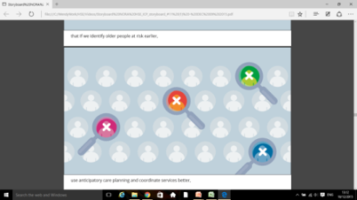


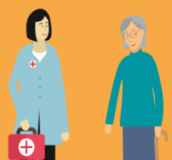

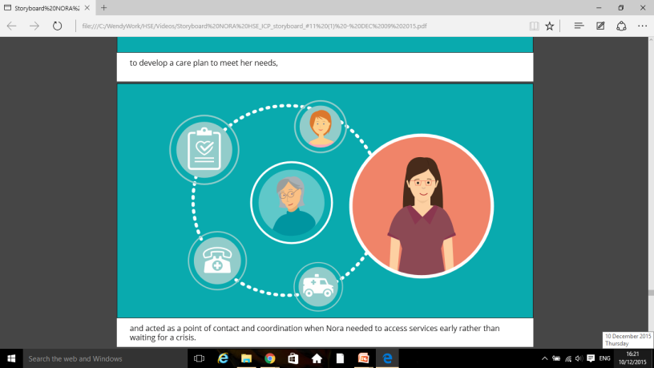
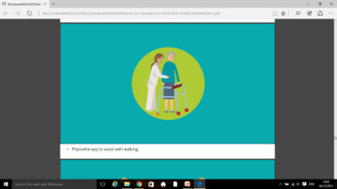

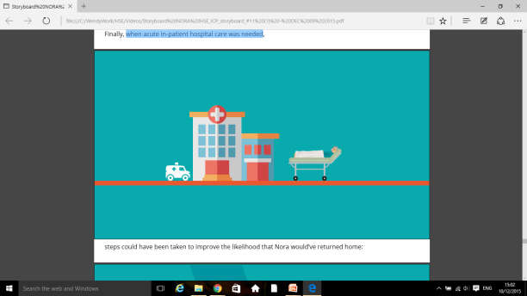

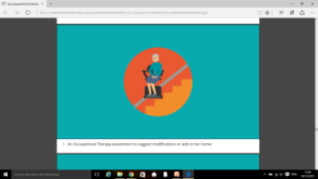

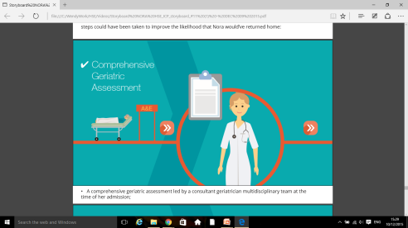
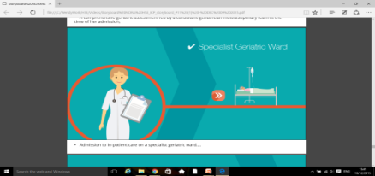
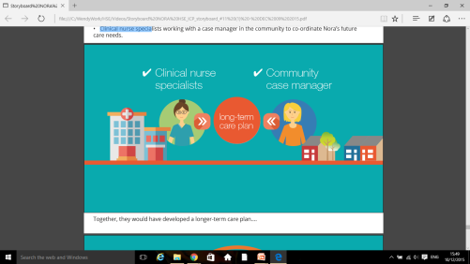
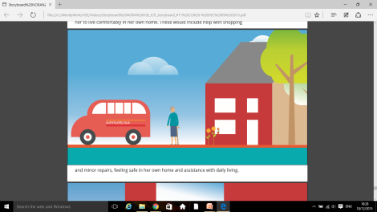

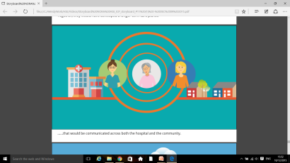
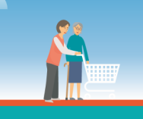
INTEGRATED CARE FOR OLDER PERSONS
SUPPORT OLDER PERSONS
TO LIVE WELL
CARE IN THE COMMUNITY
1.8 million bed days, or 76% of all bed days were used either directly (46%) or as a contributory factor (30%) by patients with the four chronic diseases
CASE MANAGEMENT
CASE FINDING
ANTICIPATORY
CARE
COMPREHENSIVE GERIATRIC ASSESSMENT
RISK IDENTIFICATION
A LONG- TERM APPROACH
React early - when issues around health start to emerge with older people
PROVIDE COMMUNITY SUPPORTS
CARE CO-ORDINATION & CARE PLANNING
CASE MANAGER for older persons
A CARE PLAN...
PHYSIOTHERAPHY
CARE
HUB
MEDICATION REVIEW
ACUTE IN-PATIENT CARE
PHN
IMPROVING THE LIKELIHOOD of RETURNING HOME
AIDS IN THE HOME
Social supports
Steps should be taken to improve the likelihood of returning home...
AFTER HOSPITAL
LONG-TERM CARE PLAN
A comprehensive geriatric assessment
SPECIALIST geriatric ward
access to practical services
in the community
SPECIALIAST TEAM
A long-term care plan :

