Slide 1



The Integrated Care Programmes
...
Dr Áine Carroll
National Director
Clinical Strategy and Programmes Division
Health Service Executive

Slide 2
Contents
Why change?
Joint working in healthcare
How?
Vision
Mission
Objectives
Are we on the right track?
The Integrated Care Programmes
  Overview of ICP for Older Persons
  Overview of ICP for Chronic Disease
  Overview of ICP for Patient Flow
What will success look like?
Driver Diagram

Slide 3
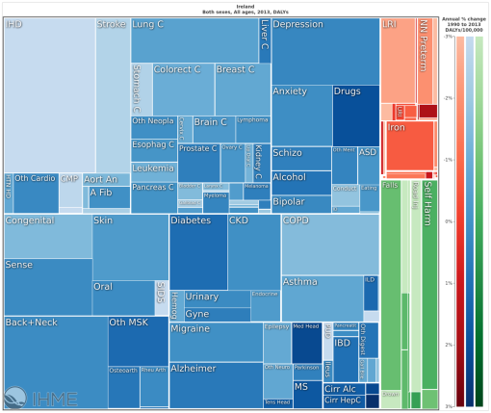

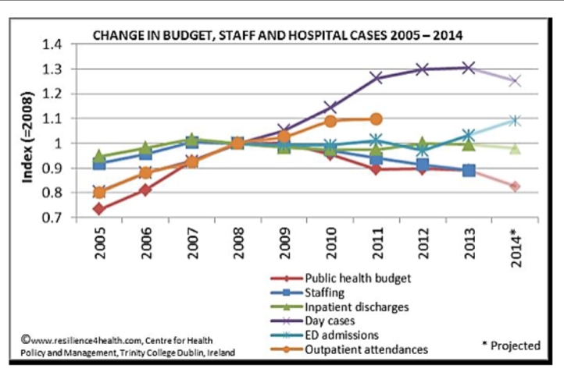
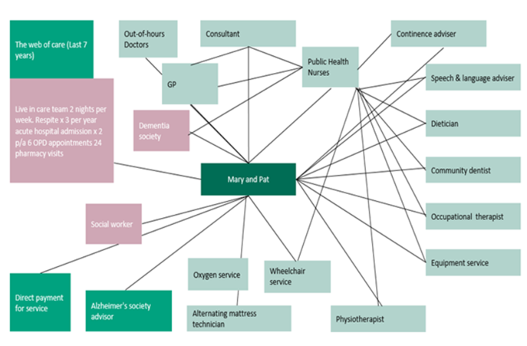
Why change?
Challenges...
Ageing population
Chronic disease
and obesity
Hospital-centric
MOC
Money
Fragmented

Slide 4
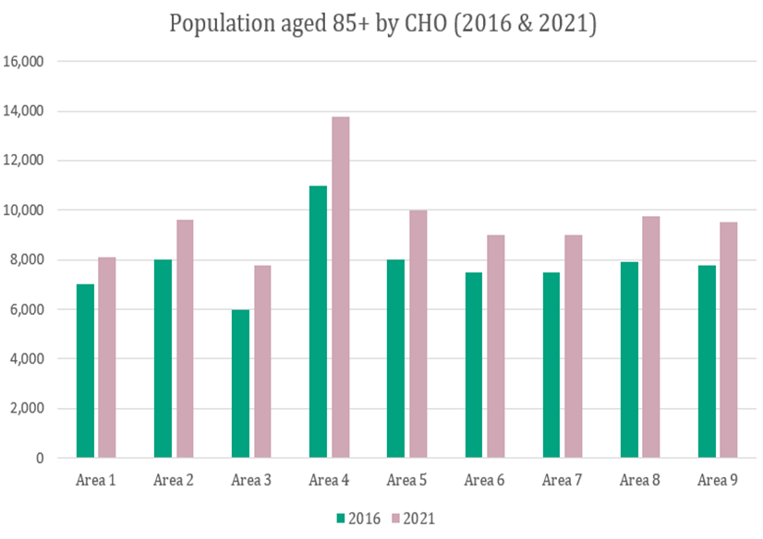
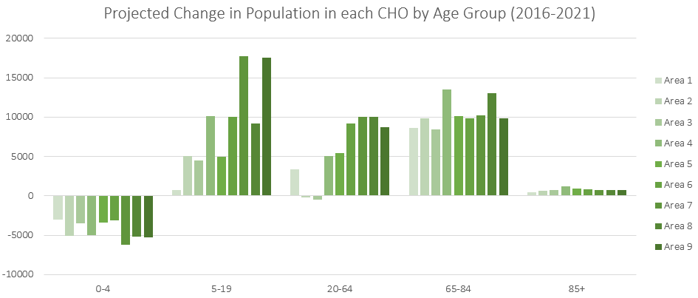
Why change?
Challenges For CHOs...
Ageing population & Population Changes

Slide 5
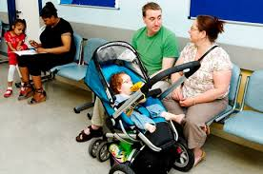
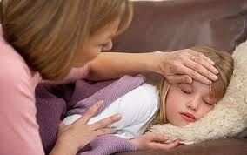

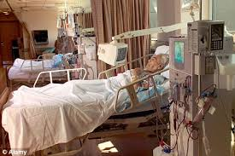
Why?
Experiences with Health Services
An elderly man spoke of the time his wife had attended a hospital in severe pain. She waited for hours to be seen by a doctor. She spent three days waiting for a transfer to a specialist hospital during which time she was on a trolley with no blankets or pillow.
When she was moved to the specialist hospital he said “it was like a war zone”. At one stage she was put into a small room which he called a “dungeon” with no call bell and very dark. She resorted to calling 999 from the room asking them where she was, after which she was moved straight away to a bed.
Once she was in recovery, she was sent to the Day Hospital and her medications were added to. She then sustained a fall attributed to multiple medications. When she attended her GP after discharge, he changed all her medications.
Source: Listening to Older People: Experiences with Health Services A collaborative exercise conducted by HSE Quality Improvement Division & Age Friendly Ireland (November/December 2014)

Slide 6
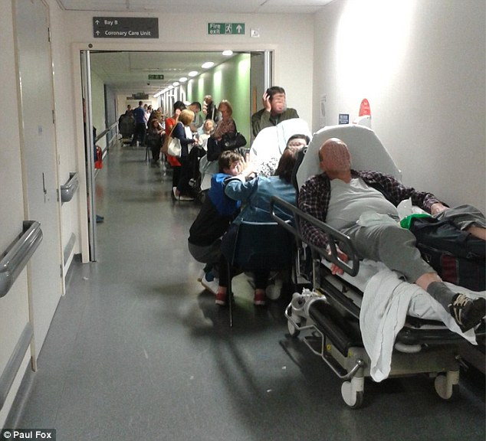
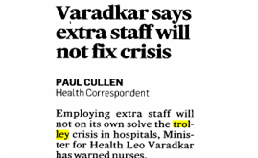

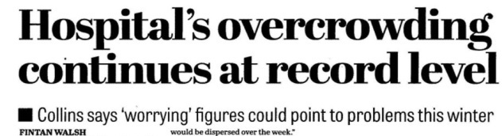
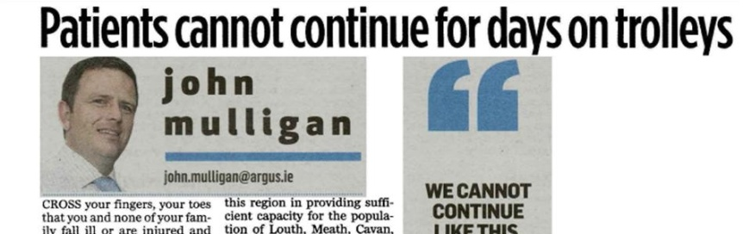
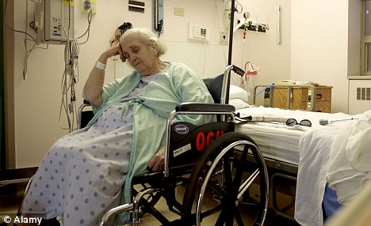


Why?

Slide 7
Joint working in healthcare:
“the indefinable in pursuit of the unachievable”
(Powell and Dowling 2006)

Slide 8
How?
Lessons from implementation: challenges to achieve sustainability and scale

Slide 9
- Frontier Economics 2012
Successful integrated care is primarily about patient experience

Slide 10
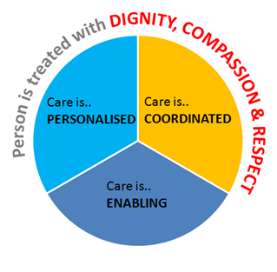
Our Vision
Person-centred, coordinated care
Person-centred care made simple October 2014 Health Foundation

Slide 11



Our Mission
Improve the quality of care
we deliver to all users
of HSE services
Improve access to
all services
Quality
Access
Value
Improve value for money and for patients

Slide 12
Objectives
Improve and standardise
high quality care
Support integration
with
Knowledge
and Information
management
Increase
accountability
for integration
Integrate
and
coordinate
care
Align finances with desired outcomes

Slide 13
Are we on the right track?
Corporate Plan for 2015 – 2017
Healthy Ireland
4 Systematic literature reviews
WHO global strategy on people-centred and integrated health services

Slide 14


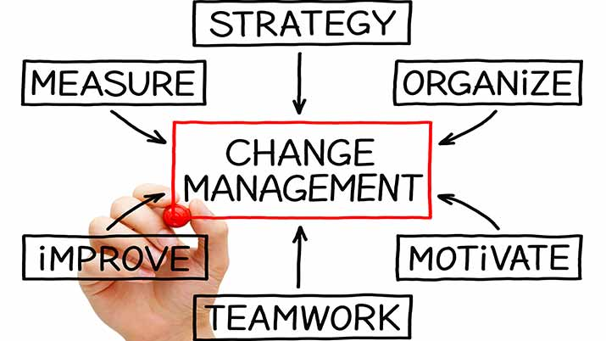

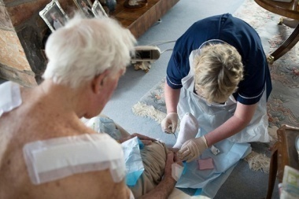


How?
To transform how we deliver care, to improve health outcomes for patients and reduce costs by:
Organising care to meet the needs of targeted patients and their carers, rather than organising services around provider structures.
Empowering and
engaging people.
Creating an enabling environment
for change.
Developing new ways of working across the patient journey to deliver better outcomes.
Providing greater access to out-of-hospital community-based care, to ensure patients receive care in the right place for them.
Designing better connected models of healthcare to utilise available resources to meet the needs of our targeted populations.
Improving the flow of information between hospitals, specialists, community and primary care healthcare providers.

Slide 15






5 Integrated Care Programmes
ICP for
Prevention and Management of Chronic Disease
5
Integrated Care Programmes
These five areas will allow us to tackle the most pressing challenges in our health and social care systems, and improve outcomes and experiences for the greatest number of patients.
ICP for
Older Persons
ICP for
Patient Flow
ICP for
Children
Person –centred, Co-ordinated
Care
ICP for
Maternity

Slide 16
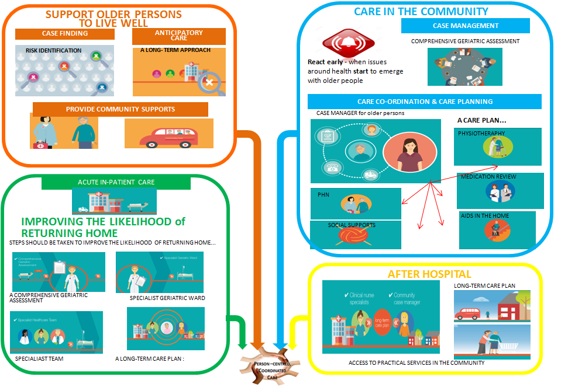
ICP for Older Persons :
User Experience Overview

Slide 17
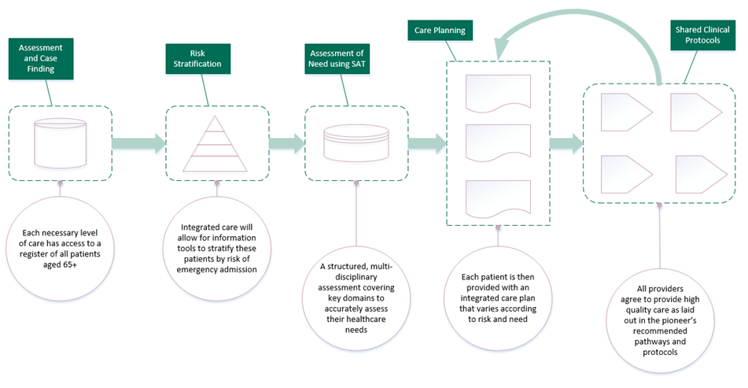
ICP for Older Persons :
Overview
Case finding and population risk stratification

Slide 18

ICP for Older Persons :
Overview
Case manager ensuring care co-ordination

Slide 19
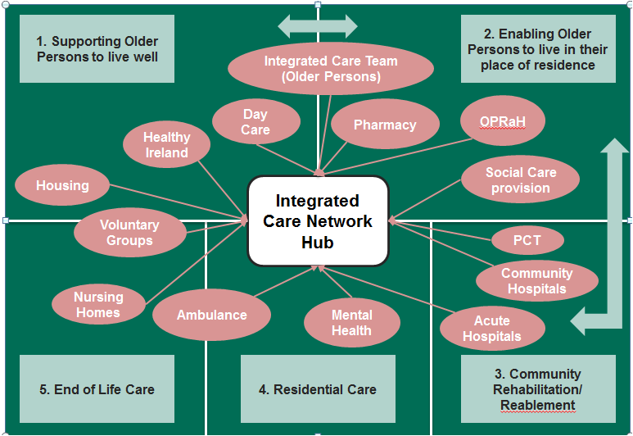
ICP for Older Persons :
Overview
Anticipatory Care Planning

Slide 20
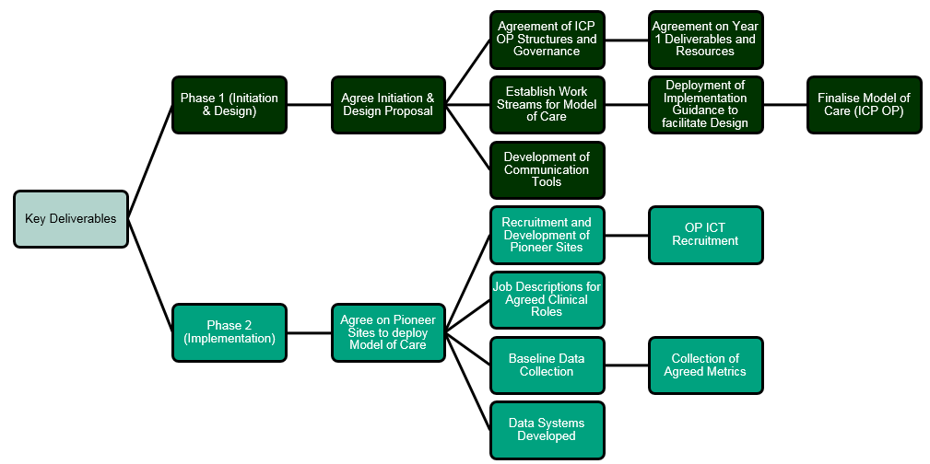
ICP for Older Persons :
Overview...
Roadmap: Programme Deliverables to 2018

Slide 21
ICP for Older Persons :
Overview...
Programme Deliverables to 2018
Engage with CHOs and Hospital Group Leadership to prepare Pioneer Areas in working towards shifting model of care building on local initiatives.
Establish governance structures in Pioneer Areas (CHOs 3, 4,7,8. Ref: SCD OP 2016).
Develop new clinical roles and care pathways to support
ICP OP.
Establish project work streams to develop and evaluate model over the next 2-3 years.
Support enhancement of care pathways and work towards a model of integrated care in non-pioneer areas (in conjunction with National Clinical Programme Older Persons.

Slide 22
ICP for Older Persons :
Overview
Summary Points
A response to long-term complex care
Integration is a fundamental principle of design rather than a system of delivery as a response to long term, complex care.
Community delivered
It is community delivered but integrated across all agencies and services.
Core elements are fundamental to integrated care
Population stratification of risk (and case finding)
Anticipatory Care Planning (based on common assessment)
Care co-ordination by a case manager (with agreed care pathways)
Local conditions
Local conditions for Integrated care to flourish needs to be created from bottom up but incentivised from top down.
Implementation is typically by ‘pioneers’
Implementation is typically by ‘pioneers’ leading on change model with dissemination and innovation as the lessons are scaled up.

Slide 23









ICP for Prevention & Management of Chronic Disease: Overview
WHO estimates chronic diseases are predicted to increase by ...
10-15% in the next
decade
Chronic diseases account for 60% of all deaths worldwide
and...
76% of deaths in Ireland
2 out of 5 hospitalisations in Ireland in 2011 occurred due to
4 of the main chronic diseases
Chronic disease
is an ongoing problem in Ireland
The rising burden of chronic disease is due mainly to lifestyle and behavioural factors
Chronic disease
is largely preventable
1.8 million bed days (76%) used directly (46%) or as a contributory factor (30%) by patients with chronic diseases
€1.68 billion (55%) of the acute hospital budget in 2011 was spent on care of patients with chronic disease
HOSPITAL
COST
Patients with chronic disease have longer length of stay - 9.9 days compared with all hospitalised patients - 8.1 days
Chronic Disease results in higher readmission rates to hospital – 23% compared with 19% for all medical conditions
75% ALL of healthcare expenditure is allocated to the treatment of chronic diseases
55% of patients say: “there are good things in our healthcare system but changes are needed to make chronic disease management better”
PATIENT-CENTRED
PRIMARY CARE
“It is important for me to have good personal knowledge of my condition and that there should be good communication between hospital teams and GPs in the overall management of my care”
Chronic disease accounts for approximately 80% of GP consultations

Slide 24
ICP for Prevention & Management of Chronic Disease: Overview
Systematic Literature Review
A clinical and economic systematic literature review was completed by University College Cork to support the Programme to provide a sound research basis for decision making. This review has made 5 health service recommendations:
1
The principal point of care for chronic disease and management needs to be located in primary care supported by specialists, secondary care and community care
2
3
4
Design and implementation of integrated care programmes and generic models of care need to be aligned with the model of care approach
5
There needs to be a shift to a population based approach to chronic disease prevention and management
Strengthen the role of nursing in disease specific prevention management by increasing the number of specialist nurses working across primary care to support integrated care
A phased and pilot approach to scale up to larger populations needs to be built into implementation planning

Slide 25


ICP for Prevention & Management of Chronic Disease: Overview
Identify ‘At Risk’ Individuals
Support Self-management
Enhance General Practice
Integrate Community Health Services
Community Health Hubs
Enhance Primary Care
Support Localities

Slide 26
ICP for Prevention & Management of Chronic Disease: Overview
HSCP
Community Pharmacist
GP
Practice Nurse
Community Nurse Specialist
GP enrolled population
Risk Stratification
Care Planning
Care Delivery and
Co-ordination
Case Manage
Disease Manage
Self -manage
Register
Clinical
Social
Risk
Shared Care Pathways and Protocols
Primary Care
Acute Care
Social Care

Slide 27
ICP for Prevention & Management of Chronic Disease: Overview
Chronic Diseases
Diabetes
COPD
Ischaemic Heart Disease
Asthma
Scope

Slide 28
ICP for Prevention & Management of Chronic Disease: Overview
Integrated
Model
of
Care
Development of Disease Registries
&
Risk Stratification
Supported
Self-
Management
Integrated
Care
Patient
Pathways

Slide 29
ICP for Prevention & Management of Chronic Disease: Overview
Appointment of the core programme team
Set up of all relevant steering, working and other consultation groups
Set up and implementation of stakeholders’ communications strategy
Set up of the Patient Experience Project in association with the HSE’s National Advocacy Unit
Uploading of detailed project plans to Project Vision
Investigation of key measures for the tracking and monitoring of Programme implementation

Slide 30
New Developments
INTEGRATED CARE PROGRAMMES
FOR PATIENT FLOW & CHILDREN:
Establishment underway
Recent appointment of two Senior Programme Managers who will work closely with their Programme Steering Groups, Clinical Leads and key stakeholders to develop and implement their respective programmes of work designed to deliver co-ordinated and person-centred care

Slide 31
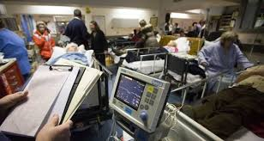

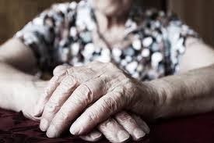



ICP for Patient Flow : Overview
Hospital overcrowding
Waiting lists
Increased demand –
Older people especially
Why?
Financial constraints
Impact of poor flow on patient outcomes
Disparate understanding and application of operation management science and related approaches
Programme Status
The Senior Programme Manager and Executive Chair are now in place and the ICP
for Patient Flow is currently in planning phase
Goal
To support seamless patient flow across all healthcare settings.

Slide 32
ICP for Patient Flow : Overview
Vision
To provide safe, efficient and
high quality patient care in an integrated model across health and social care services
What it
means
Aligning management processes and clinical services across the hospital and community settings to optimise resource and capacity usage, standardising care by incorporating the work of the National Clinical Programmes and delivering health and social care in the safest and most clinically and cot-effective manner
What it
delivers
Improved clinical outcomes for patients
Timely and appropriate quality access to care for patients
Improved patient experience
More efficient use of resource to match capacity to demand
Improved staff morale
Clinical
leadership, governance and standards
Patient flow planning and pathway management
Patient information (clinical information and demographics)
Improved resource allocation
ICT
Enablers

Slide 33
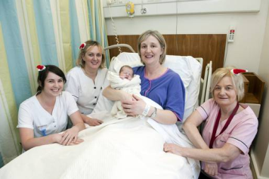


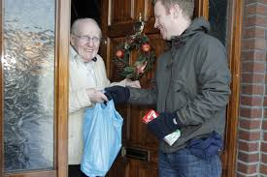
What will success look like?
Patients reporting
that they can more easily navigate their journey
through the various parts of our health system
Patients reporting involvement in decision making
Positive staff feedback and staff reports
Improved patient experience, and better health outcomes
Person –centred, Coordinated
Care
Better sharing of clinical information
Reduced waiting times for patients as they navigate the system
More patients
cared for in the community receiving their care there, with a reduction in avoidable hospitalisations and frequency of hospital admissions and Emergency Department attendance

Slide 34


Slide 35
Driver Diagram
AIM
PRIMARY DRIVERS
SECONDARY DRIVERS
Person-centred
coordinated care
Integrate and coordinate care
Increase accountability for integration
Improve and standardize high quality care
Support integration with information management
Align finances with desired outcomes
Models of care
Managing urgent and emergency activity
Active support for self management
Prevention
Ambulatory care
Care co-ordination
E-Health
Financial models

Slide 36
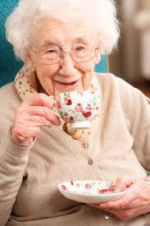




Imagine!
I know what number to call!
I feel so much better for not having to go all the way to hospital
I’m alive because I had specialist care really fast
It’s great to share and learn so much with this group
It’s like everyone knows all about me

Slide 37



Thank you
Visit our website:
www.hse.ie/integratedcare/
Interact with us on:
@CSPD_HSE
nationalcsp@hse.ie

