Slide 1

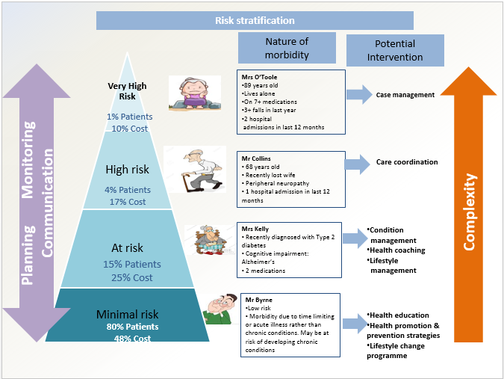




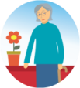







Step-by-step Integrated Care Model for Older Persons
Whole system change: supporting older persons
to live well at home in the community is at the centre
1
Establish Governance STRUCTURES
2
UNDERTAKE Population planning FOR OLDER PERSONS
3
Map local care resources
4
Develop Multi-disciplinary teamwork
Co-ordination between care providers
Falls
Prevention
9
Medication Management
(Pharmacist & GP)
Supports to live well
Support for older persons to
live well in the community
6
develop CARE PATHWAYS
Information & Advice
Community Transport
Dementia, Falls, POLYPharmacy
AMBULATORY CARE
ACUTE CARE pathways
Older Person
Residing At Home
Social
Activities
Home modifications & handy person
7
DEVELOP ENABLERS
HARNESS TECHNOLOGY
ALIGN FINANCE (VALUE)
DEVELOP WORKFORCE
Shopping
5
Develop New ways of working
New roles including Case Management FOR long term complex needs
In-reach and outreach
UTILISE EVIDENCE BASED INTERVENTIONS;
            MEASURE OUTCOMES
            ADOPT AN EVIDENCE-BASED APPROACH
8

